Slide 1
Supporting Students:
CARE & Title IX Referrals

Slide 2
CARE Reports
Crisis – Assessment – Referral – Evaluation

Slide 3
What is CARE?
CARE is an acronym for Crisis, Assessment, Referral, & Evaluation
Common CARE concerns are:
  Thoughts of Suicide or Intent
  Victim of Crime
  Self-Injury Behavior
  Alcohol and Other Drugs
  Odd or Unusual Behavior

Slide 4

When should I submit a referral?

Slide 5

What Happens after a referral?
The referral is reviewed by the CARE Team, and a case is created
  Outreach to the student of concern is attempted until the student is verified safe
  Student advocacy & support are provided

Slide 6
Questions?

Slide 7
Title IX
Mandatory Reporting Requirements

Slide 8
Step 1: know the issues
What conduct does the Gender-Based Misconduct & Title IX policy address?
  Sexual Assault
  Dating Violence
  Domestic Violence
  Stalking
  Sexual Harassment
    Quid Pro Quo
    Hostile Environment
  Gender-Based Discrimination
  Retaliation
  Battery
  Sexual Exploitation
  Indecent Exposure
Notes:
The policy applies to conduct on- and off-campus. You should report it, even if you know the respondent is not affiliated or if you don’t know who the respondent is.
Note that Title IX is specific to gender- and sex-based misconduct. Harassment based on other protected categories (such as race, religion, national origin, disability status, etc.) should be reported to Student Conduct.
You don’t have to know where the conduct falls under the policy to report it. You don’t need to be an expert, just to be able to recognize potentially prohibited conduct under Title IX.
When in doubt, report it!

Slide 9

Step 2: Responding to a disclosure
Assess whether there is an immediate threat.
Inform the student of your reporting obligations.
Listen without judgment.
You may offer to immediately connect the student with resources.
Notes:
If there is an immediate threat, you may need to call the police and consider emergency housing.
It’s okay to interrupt a student to make sure they are aware you are a mandatory reporter – they may decide not to share any details with you, and that is okay. Students can report to confidential resources (Hope & Healing, Counseling, Health Services)
You can help connect them with Counseling or Hope & Healing. We will also inform them of these resources in our outreach, but you can also help connect them immediately.
Chloe from Hope & Healing is going to go into more detail on this later.

Slide 10

Step 3: Your reporting obligations
Complete a referral
Report what you know
Be timely
Don’t investigate
Notes:
1. We welcome phone calls and emails if you need guidance. There is an online form – bookmark it!
2. You are required to report any details you are aware of (example: you cannot keep complainant’s identity anonymous if you know the complainant’s identity)

Slide 11

Options for reporting
Online https://www.uakron.edu/help
By Phone
(330) 972-6048
In-Person
152 Student Union

Slide 12

Step 4: following up
It is okay to ask how the student is doing.
Keep the information private.
Don’t treat the student differently.
Notes:
Allow the student to bring up the events only if they want to.
Don’t bring up the situation in front of other students or tell others about it.

Slide 13

What happens next?
Report = Support
Supportive measures
Empowering the student to decide next steps
Notes:
A lot of reporters want to know what happens after they submit a report.
Students may sometimes feel overwhelmed by the options. We will seek to understand each student’s situation and identify which options are suitable for them and their needs. It’s a personalized process.
First and foremost, we want you to remember that report = support. We want to make sure they’re okay and see how we can immediately help.
Supportive measures – do not seek to punish either party. They are put in place to ensure all students have access to their education, formal complaint not required (changes to housing, academic advocacy, no contact directives, etc.)
In a vast majority of cases, we do not move forward unless the complainant chooses to, but we do need to assess the safety of the university community.

Slide 14
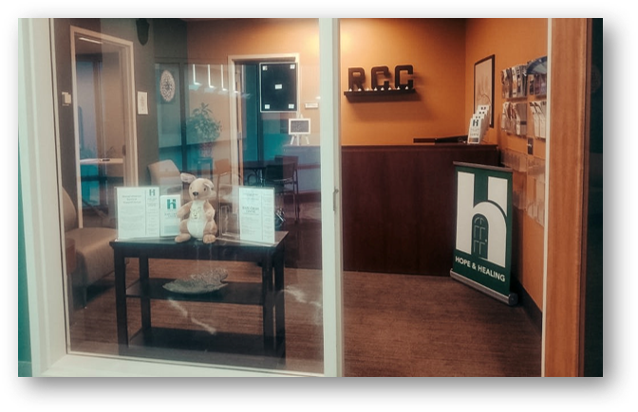


Hope & Healing
(330) 374-1111
246 SRWC

Slide 15
Links and resources
Dean of Students Office Linktree (CARE and Title IX Referral forms)
  https://linktr.ee/uakrondeanofstudents?utm_source=linktree_admin_share
Student Conduct Referral Form
  https://cm.maxient.com/reportingform.php?UnivofAkron
Help-A-Zip
  https://www.uakron.edu/referral/

Slide 16
Questions?

